Slide 1



SCIE5508 Synthetic Biology – Solving global challenges
Lecture 1 – Introduction to the unit
Dr. Georg Fritz (Unit coordinator)
Senior Lecturer
School of Molecular Sciences
Location: Bayliss Building, room 3.69
Email: georg.fritz@uwa.edu.au
Phone: 6488 3329
Office hours: By appointment

Slide 2

Notes:
I would like to acknowledge that this lecture is being held on Aboriginal land and recognise the strength, resilience and capacity of Noongar people in this land.

Slide 3
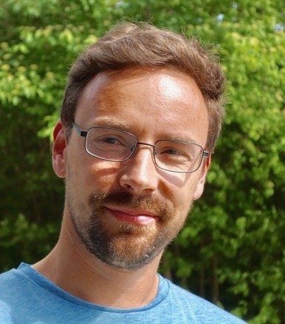



A bit about myself…
2000-2006 Studied Theoretical Physics, Univ. Freiburg, Germany
2006-2012 PhD in Biological Physics, LMU Munich
2012-2014 Postdoc in Synthetic Microbiology, LMU Munich
2014-2019 Group leader, Center of Synthetic Microbiology, Marburg
Since Oct 2019 Senior Lecturer @UWA
Freiburg
Munich
Dr. Georg Fritz
School of Molecular Sciences
georg.fritz@uwa.edu.au
Marburg
Notes:
Introduction of the lecturers

Slide 4
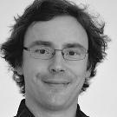
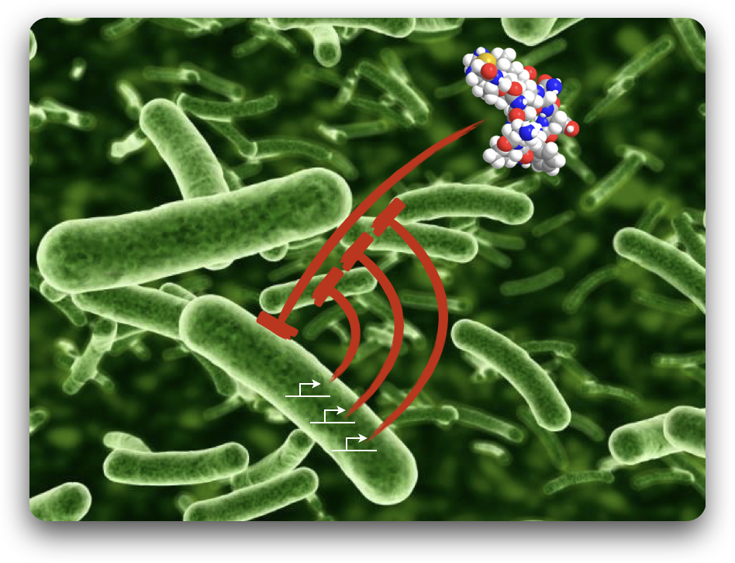
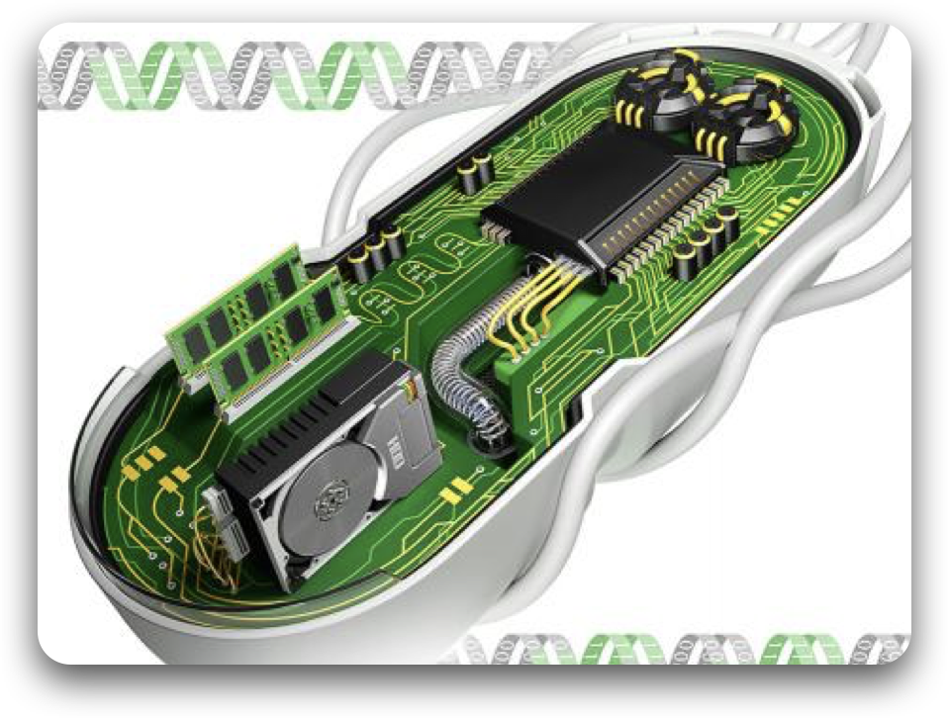
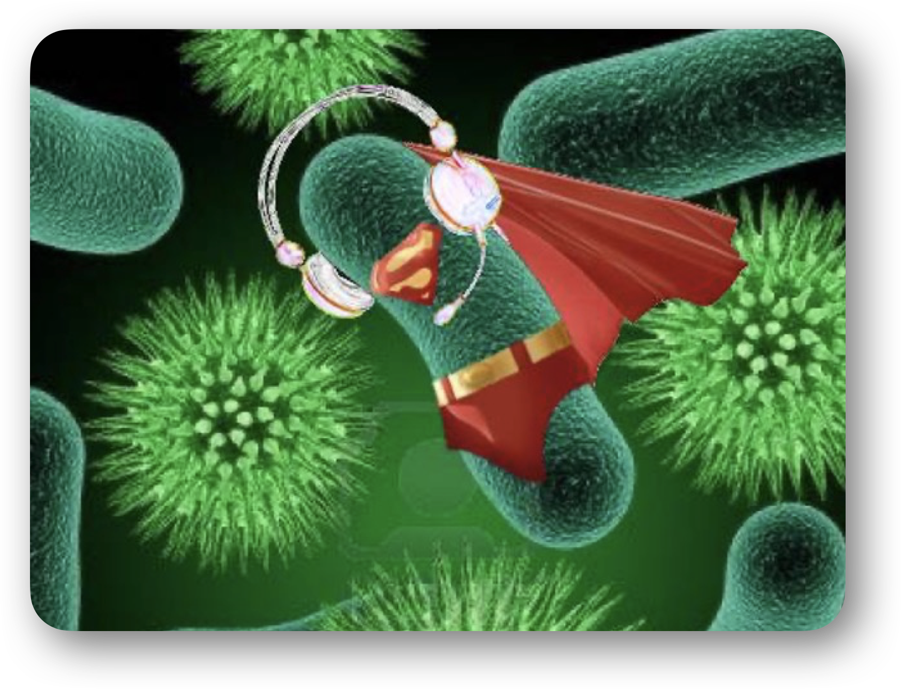
Our mission is to…
… crack antimicrobial resistance
… build tools for bioengineering
… engineer metabolic pathways
Dr. Georg Fritz
School of Molecular Sciences
georg.fritz@uwa.edu.au
Systems and synthetic biology of microbial regulatory networks
Notes:
Introduction of the lecturers

Slide 5
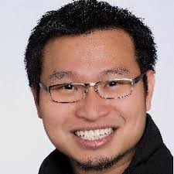
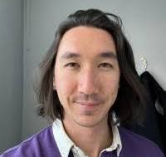
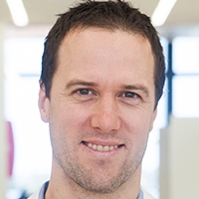
Lecturers of SCIE5508
Dr. Georg Fritz
School of Molecular Sciences
georg.fritz@uwa.edu.au
Systems and synthetic biology of microbial regulatory networks
A/Prof. Yit-Heng Chooi
School of Molecular Sciences
yitheng.chooi@uwa.edu.au
Molecular genetics and biochemistry of secondary metabolite biosynthesis
Dr. Farley Kwok Van Der Giezen
School of Molecular Sciences farley.kwokvandergiezen@uwa.edu.au
Molecular biology, systems biology of plant development
Prof. Ryan Lister
School of Molecular Sciences
ryan.lister@uwa.edu.au
Biochemistry and molecular biology of epigenetic control in eukaryotes
Notes:
Introduction of the lecturers

Slide 6
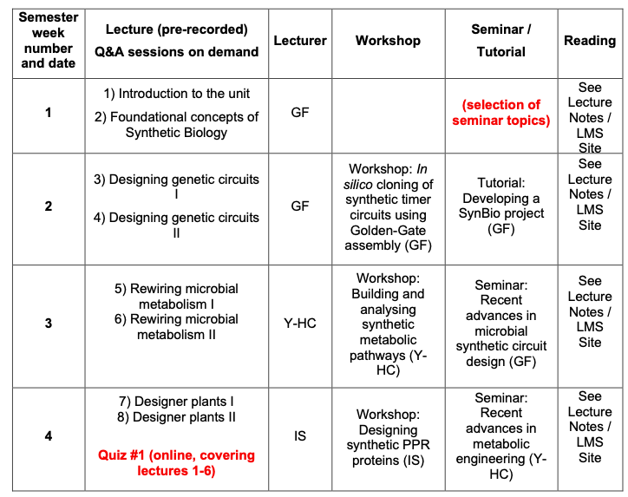
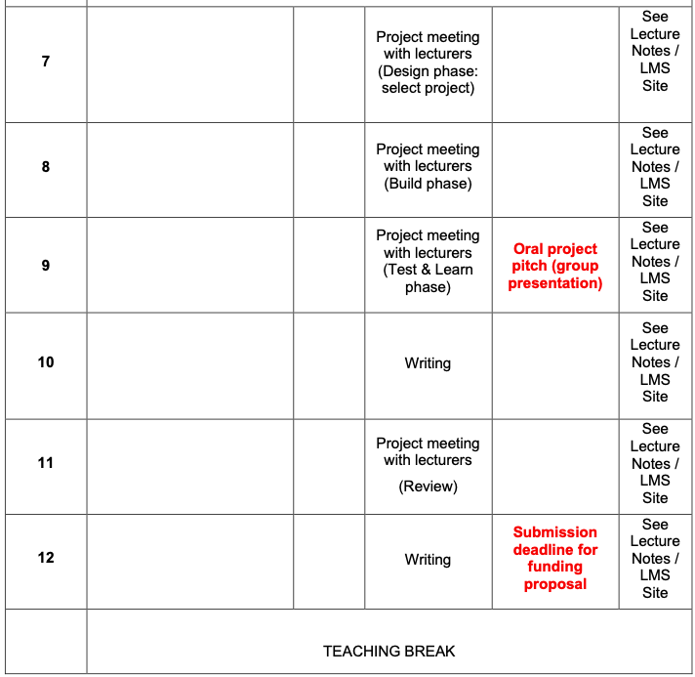
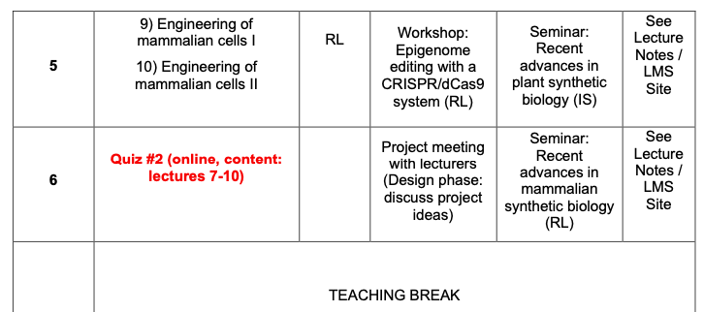
Unit outline
Notes:
Overview on Unit outline

Slide 7
Schedule weeks 1-6
Lectures: Online (pre-recorded, 2 x ~45min)
Q & A sessions: Online (live); 1 session per week, Wednesday 5-6 pm (weeks 1-5)
Workshops: Thursday, 15:00–18:00, RBST: [G16] Robert Street LT, weeks 2 – 5
Seminars: Friday, 15:00–17:00, Simmonds Lecture Theatre G01, weeks 2–6

Slide 8
Schedule weeks 6-12
Self-study time: Read literature & develop project
Student group meetings: Develop project & prepare discussion with supervisor (1-2h/week minimum)
Project meetings: Scheduled by lecturer, 1 hour per week online mentoring on demand (via MS Teams)

Slide 9
Workshops
Prepare: Maximize hands-on training by studying the theoretical concepts before the workshop (materials on LMS)
Hands-on training: Learn how to design genetic constructs using DNA management software
Examine real-world data
Get to know our experimental setups
Notes:
Tasks and objectives in workshop

Slide 10
Seminar (journal club)
Choose a recent Synthetic Biology paper from pre-selected list (see LMS); provide 3 choices by the end of week 1 via an LMS survey
We assign you in teams of 3 students (random assignment on LMS)
Prepare ~10-12 Powerpoint slides to cover the background, experimental concept, main findings and conclusion of the work1
Present a 10-12 min talk to your peers (WE EXPECT A FREE SPEECH WITH PPT SLIDES - NO NOTES ON PAPER OR PPT ALLOWED! NO READING OF FULL SENTENCES FROM PPT SLIDES! THE USE OF NOTES / READING OFF THE SCREEN WILL LEAD TO A PENALTY OF 5 MARKS (OUT OF 20 MARKS TOTAL)
Discuss the work for 3-5 min in a Q&A session
Notes:
Student tasks in seminar

Slide 11
Project: Develop a Synthetic Biology funding proposal
Challenge: Propose a Synthetic Biology project using a multi-gene construct (sensory & regulatory circuit, metabolic pathway, etc.) to address a topical problem (environmental, agricultural, biotechnological, medical, etc.)
Teams of 4 students (team-assignment via poll, management on MS Teams)
3 phases: Design (weeks 6 & 7), build (weeks 8), test & learn (week 9)
Present an oral pitch of your proposal (5 min group presentation, week 9)
Write funding proposal describing the 3 phases (Intro + 1 section/student) – more details will be given in a tutorial in week 2
Notes:
Description of project work

Slide 12

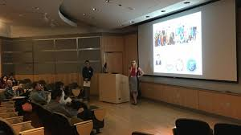

Assessments
Quizzes 25% (In weeks 3 & 5)
Oral 35%
Seminar talk (20%)
Active participation in Q&A sessions (5%)
Project pitch (10%)
Written proposal 40%
Late submissions will be penalised with 5% per 24h block
Notes:
Contribution of assessment items to final mark

Slide 13
Attendance
If you have a clash with an element of the unit please let me know ASAP. Attendance in workshops and seminars is compulsory (sessions are not recorded).
If you cannot make the assessment submission deadline please see the Science Student Office (SSO), well in advance of the due date or else you will be penalized for late submission.
Notes:
Contribution of assessment items to final mark

Slide 14
Support & resources
If you are struggling with the assessment and require guidance/clarification, please see the lecturer/unit coordinator
If you have problems with reading/writing/speaking (incl. English language) please take advantage of UWA’s STUDY smarter resources
Notes:
Contribution of assessment items to final mark

Slide 15
Other information
No recommended textbook for the unit. See individual lecture notes and workshop materials for suggested readings on LMS
Plagiarism: any doubts about what constitutes plagiarism, see http://www.science.uwa.edu.au/students/sing-current-students/assessments/dishonesty
A note about contacting academic and professional staff by email: Writing a professional email is a generic skill that you should acquire while at UWA. Email messages should be polite, considerate, and contain correct grammar and spelling. All should begin with an appropriate salutation, e.g. “Dear...”, and end with a suitable closing, e.g. “Regards...”
Do not expect an answer to an email outside of business hours (Monday – Friday, 9.00 – 17.00). Please check the “Announcement” section in the unit’s LMS page before sending an email. Your question may have already been addressed.
Notes:
Contribution of assessment items to final mark

Slide 16
Learning Management System (LMS)
Unit Outline and detailed schedule of lectures, workshops and seminars
Assignment Coversheet/Plagiarism Declaration Form, Lecture Notes & Recordings
Assessments release and submit
Discussion Board (Forums)
Each lecture has a Q & A forum (remember: gain 5% of your mark via active participation)
No guarantee that lecturer will check the discussion board, so contact them directly with any queries or comments
Notes:
Contribution of assessment items to final mark

Slide 17
Questions?

